Slide 1

Introduction to Statistics
mathematics 3

Slide 2
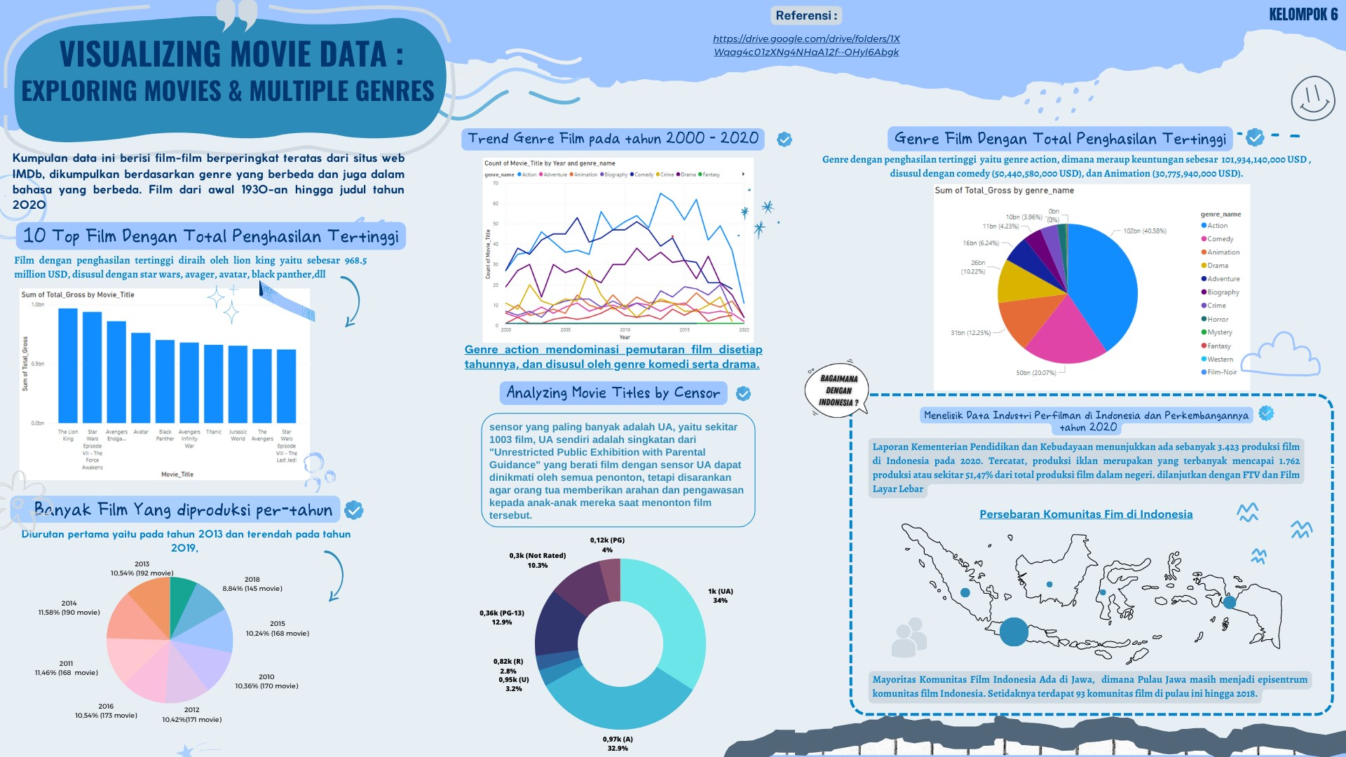

Slide 3
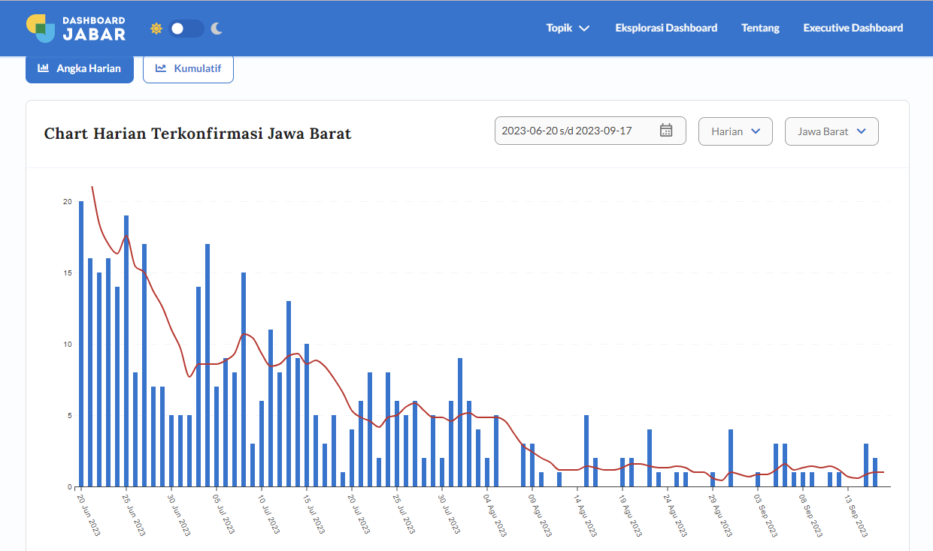
https://dashboard.jabarprov.go.id/id/dashboard-pikobar/trace/statistik

Slide 4
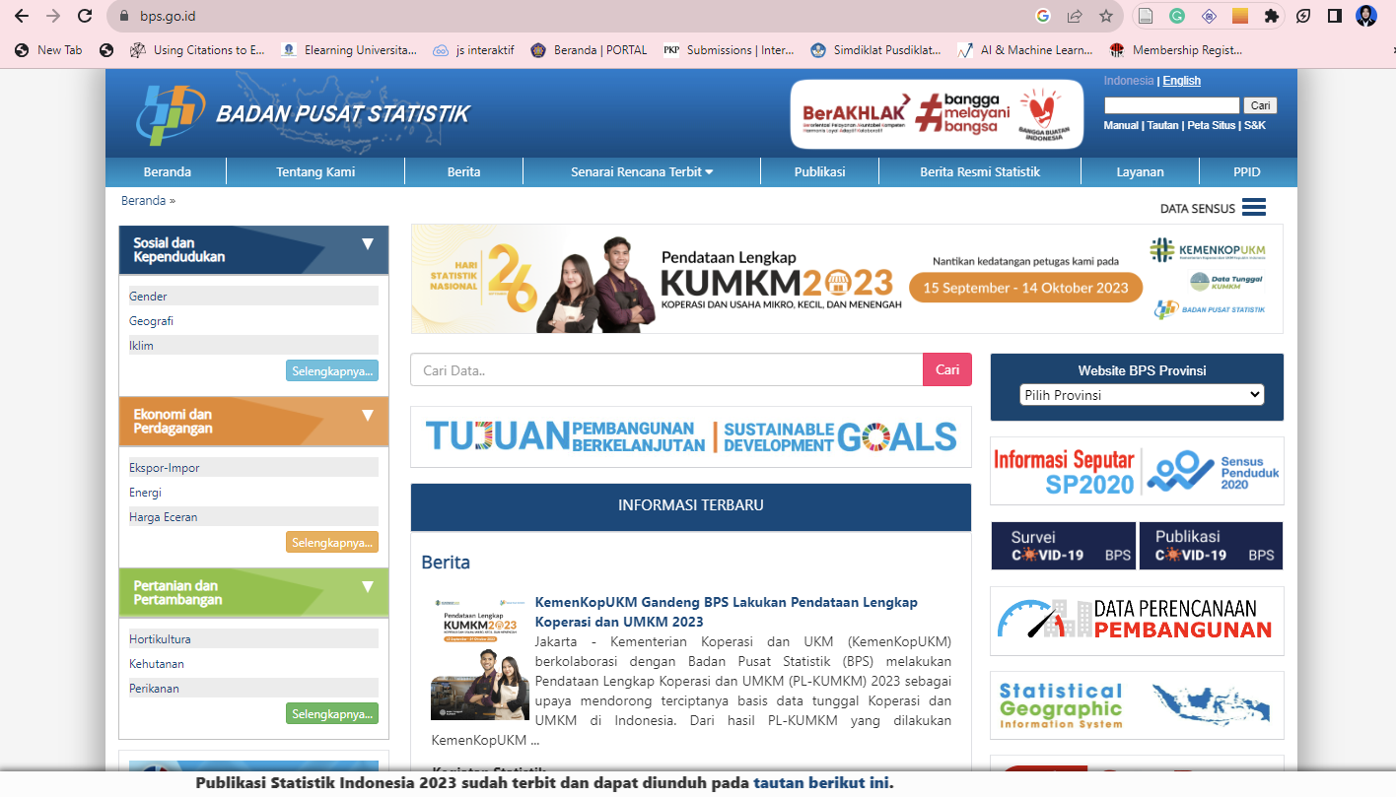
https://www.bps.go.id/

Slide 5
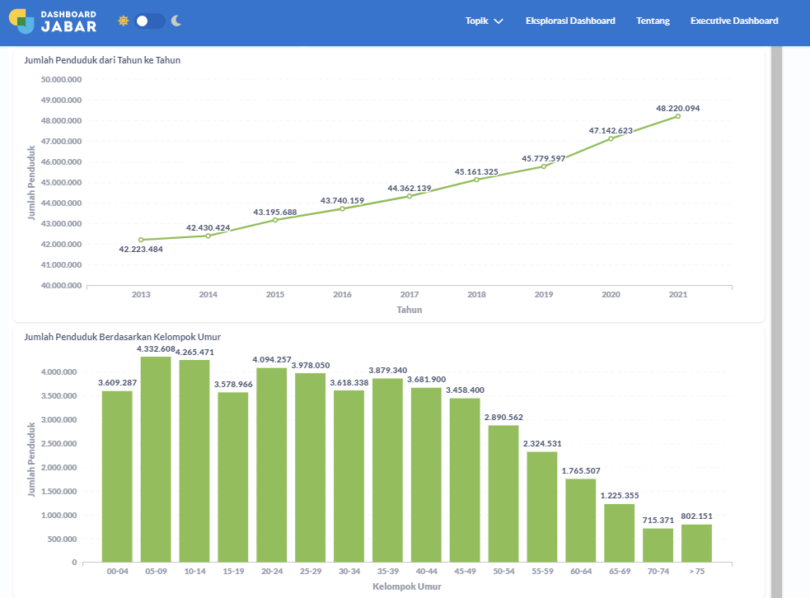

Slide 6
INTRODUCTION TO STATISTICS
A
B
Data
Mean
(Average)
Median
Modus
C
(Middle Value)
(Frequently occurring values)
D

Slide 7
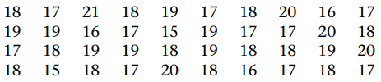
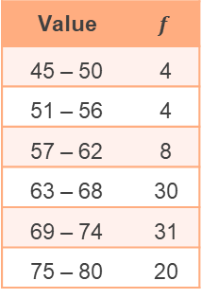
Data
Statistics deals with collecting, sorting, and analyzing data. Data consists of a collection of recorded observations or values.
Data can be written in the form of single data and group data. Group data writing will help when the amount of data is very large.
The number of events in which a particular value occurs is called the frequency (𝑓).
Example of Single Data form
Example of Group Data form
Value | $$f$$
45 – 50 | 4
51 – 56 | 4
57 – 62 | 8
63 – 68 | 30
69 – 74 | 31
75 – 80 | 20

Slide 8
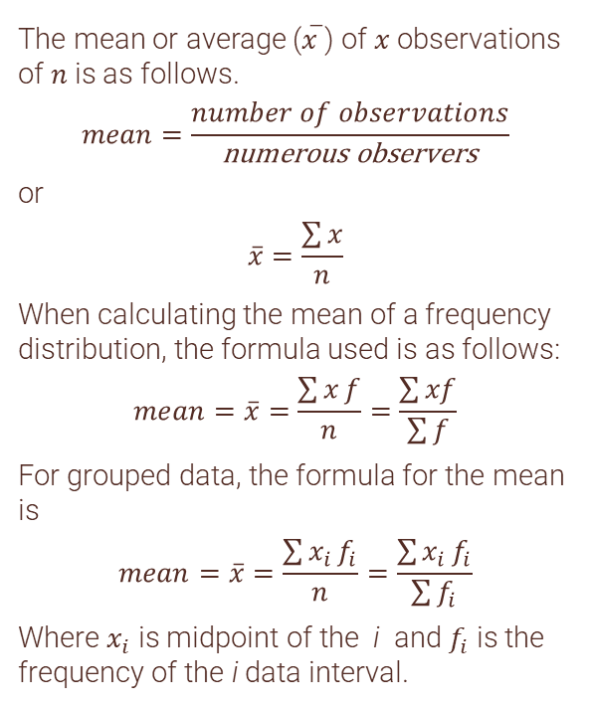


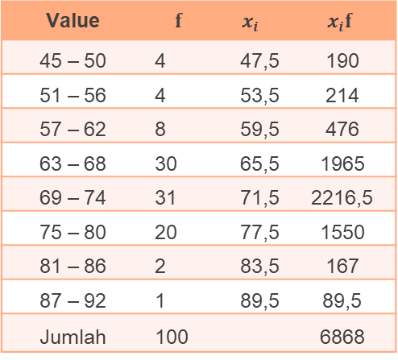
example
CONCEPT 1
Mean
Single data: $2,2,6,7,7,7,10,13$
The mean is (2+2+6+7+7+7+10+13)/8
= 6.75
The mean or average (𝑥 ̅) of 𝑥 observations of 𝑛 is as follows.
$$mean=\frac{number of observations}{\text{numerous} \text{observers}}$$
or
$$\overline{x}=\frac{\sum{x}}{n}$$
When calculating the mean of a frequency distribution, the formula used is as follows:
$$mean=\overline{x}=\frac{\sum{x}f}{n}=\frac{\sum{xf}}{\sum{f}}$$
For grouped data, the formula for the mean is
$$mean=\overline{x}=\frac{\sum{x_{i}}f_{i}}{n}=\frac{\sum{x_{i}}f_{i}}{\sum{f_{i}}}$$
Where $x_{i}$ is midpoint of the i and $f_{i}$ is the frequency of the i data interval.
Value | $$f$$ | $$x_{i}$$ | $$x_{i}f$$
45 – 50 | 4 | 47,5 | 190
51 – 56 | 4 | 53,5 | 214
57 – 62 | 8 | 59,5 | 476
63 – 68 | 30 | 65,5 | 1965
69 – 74 | 31 | 71,5 | 2216,5
75 – 80 | 20 | 77,5 | 1550
81 – 86 | 2 | 83,5 | 167
87 – 92 | 1 | 89,5 | 89,5
Jumlah | 100 |  | 6868
Venus has a beautiful name and is the second planet from the Sun. It’s terribly hot—even hotter than Mercury—and its atmosphere is extremely poisonous. It’s the second-brightest natural object in the night sky after the Moon
So that
$$\overline{x}=\frac{\sum{x_{i}}f_{i}}{\sum{f_{i}}}=\frac{6868}{100}=68,68$$

Slide 9
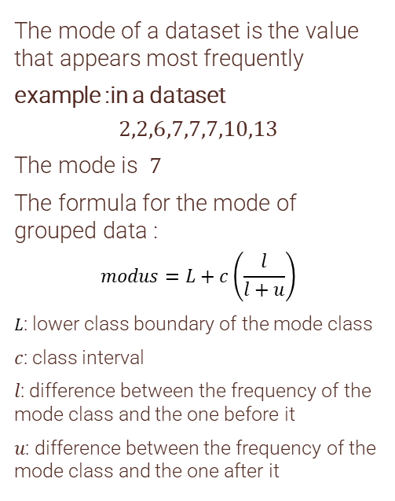
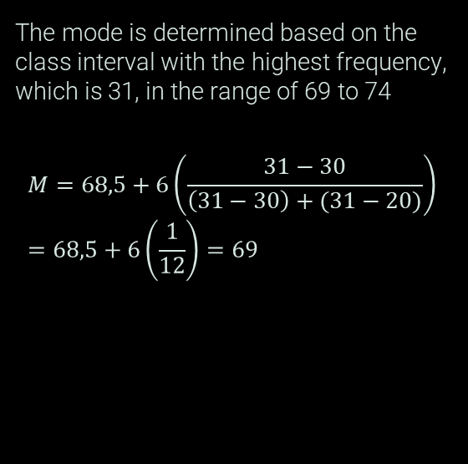
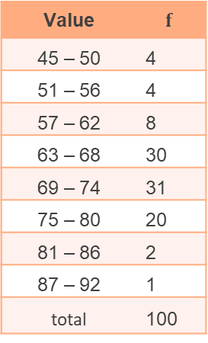
exAMPLE
Modus
Value | $$f$$
45 – 50 | 4
51 – 56 | 4
57 – 62 | 8
63 – 68 | 30
69 – 74 | 31
75 – 80 | 20
81 – 86 | 2
87 – 92 | 1
total | 100
The mode of a dataset is the value that appears most frequently
example :in a dataset
$$2,2,6,7,7,7,10,13$$
The mode is $7$
The formula for the mode of grouped data :
$$modus=L+c\left(\frac{l}{l+u}\right)$$
𝐿: lower class boundary of the mode class
𝑐: class interval
𝑙: difference between the frequency of the mode class and the one before it
𝑢: difference between the frequency of the mode class and the one after it
The mode is determined based on the class interval with the highest frequency, which is 31, in the range of 69 to 74
$$M=68,5+6\left(\frac{31−30}{\left(31−30\right)+(31−20)}\right)=68,5+6\left(\frac{1}{12}\right)=69$$

Slide 10
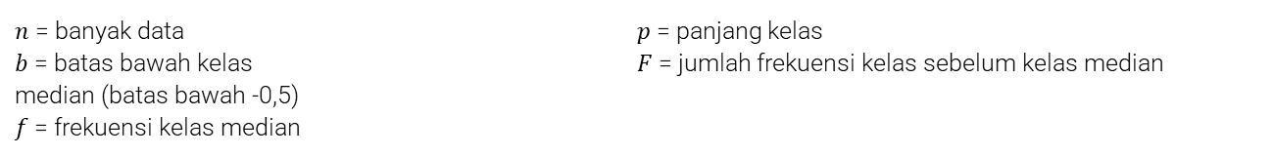
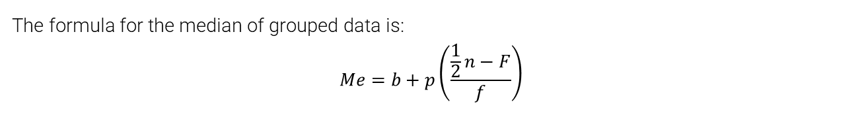
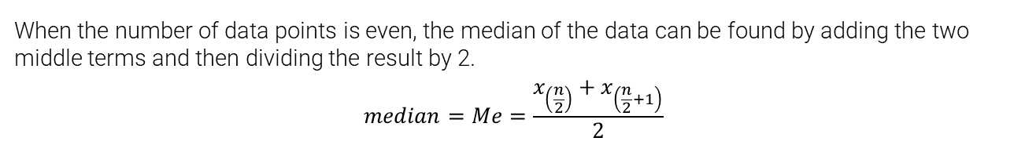
Median
The median is the middle value of a dataset when the data is arranged in ascending or descending order.
Example :
The median or middle value of the data 4, 7, 8, 9, 12, 15, 26 is 9.
When the number of data points is even, the median of the data can be found by adding the two middle terms and then dividing the result by 2.
$$median=Me=\frac{x_{\left(\frac{n}{2}\right)}+x_{\left(\frac{n}{2}+1\right)}}{2}$$
The formula for the median of grouped data is:
$$Me=b+p\left(\frac{\frac{1}{2}n−F}{f}\right)$$
$n$ = banyak data
$b$ = batas bawah kelas
median (batas bawah -0,5)
$f$= frekuensi kelas median
$p$ = panjang kelas
$F$ = jumlah frekuensi kelas sebelum kelas median

Slide 11
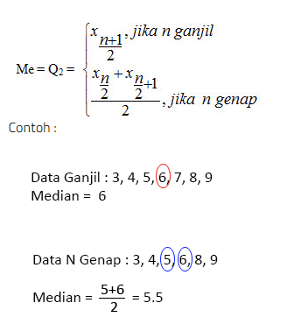
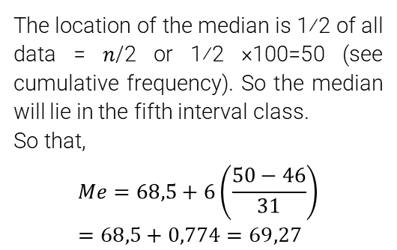
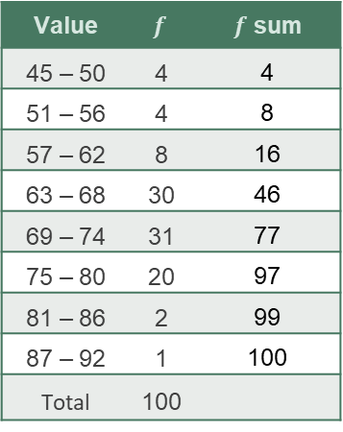
Median
example
(group data)
Value | $$f$$ | $f$ sum
45 – 50 | 4 | 4
51 – 56 | 4 | 8
57 – 62 | 8 | 16
63 – 68 | 30 | 46
69 – 74 | 31 | 77
75 – 80 | 20 | 97
81 – 86 | 2 | 99
87 – 92 | 1 | 100
Total | 100
The location of the median is 1⁄2 of all data = 𝑛/2 or 1⁄2 ×100=50 (see cumulative frequency). So the median will lie in the fifth interval class.
So that,
$$Me=68,5+6\left(\frac{50−46}{31}\right)=68,5+0,774=69,27$$

Slide 12
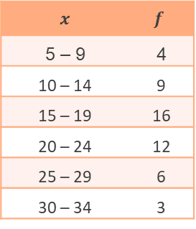
Question 1
Determine the mean, median, and mode of the following data.
$x$ | $$f$$
5 – 9 | 4
10 – 14 | 9
15 – 19 | 16
20 – 24 | 12
25 – 29 | 6
30 – 34 | 3

Slide 13
QUESTION 2
Give 3 examples and explain each of the benefits of mean, median and mode in everyday life

Slide 14
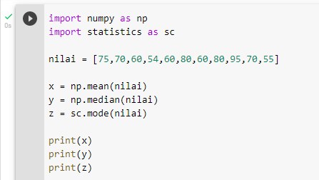
QUESTION 3
Type the following code and calculate manually, is the result the same?

Slide 15
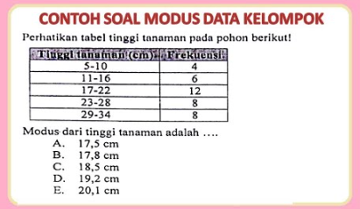
QUESTION 4

Slide 16
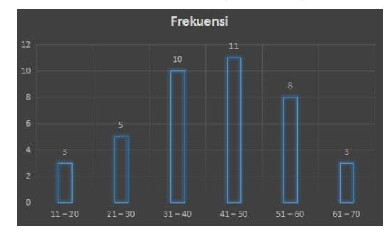
QUESTION 5
Determine the mean and median

